Slide 1
perl
by
Jana Tulasi Naga Durga

Slide 2
Introduction to Perl
Perl is a general-purpose, high level interpreted and dynamic programming language. At the beginning level, Perl was developed only for the system management and text handling but in later versions, Perl got the ability to handle regular expressions, and network sockets, etc. In present Perl is popular for its ability to handling the Regex(Regular Expressions).

Slide 3
Topics:
Basics
Fundamentals
Datatypes
Input and Output
Control Flow

Slide 4
1.Basics
Introduction to Perl
Advantages of Perl
Applications of Perl
Installation and Environment Setup(Linux & Windows)
Syntax of a Perl Program
Hello World Program in Perl
How to Run a Perl Program

Slide 5
Introduction to Perl
Perl(Practical Extraction and Reporting Language) is a general-purpose, high level interpreted and dynamic programming language.
At the beginning level, Perl was developed only for the system management and text handling but in later versions, Perl got the ability to handle regular expressions, and network sockets, etc.
In present Perl is popular for its ability to handling the Regex(Regular Expressions).
Perl supports both the procedural and Object-Oriented programming.

Slide 6
why perl?
Perl has many reasons for being popular and in demand. Few of the reasons are mentioned below:
Easy to start: Perl is a high-level language so it is closer to other popular programming languages like C, C++ and thus, becomes easy to learn for anyone.
Text-Processing: As the acronym “Practical Extraction and Reporting Language” suggest that Perl has the high text manipulation abilities by which it can generate reports from different text files easily. Also, it can convert the files into some another form

Slide 7
why perl Cont..
Contained best Features: Perl contains the features of different languages like C, sed, awk, and sh etc. which makes the Perl more useful and productive.
sed ("stream editor") is a Unix utility that parses and transforms text, using a simple, compact programming language.
AWK (awk) is a domain-specific language designed for text processing and typically used as a data extraction and reporting tool. Like sed and grep, it's a filter, and is a standard feature of most Unix-like operating systems
A shell(sh) script is a computer program designed to be run by the Unix shell, a command-line interpreter.

Slide 8
why perl Cont..
System Administration: Due to having the different scripting languages capabilities Perl make the task of system administration very easy. Instead of becoming dependent on many languages, just use Perl to complete out the whole task of system administration. In Spite of this Perl also used in web programming, web automation, GUI programming etc.
Web and Perl: Perl can be embedded into web servers to increase its processing power and it has the DBI package, which makes web-database integration very easy.

Slide 9
Advantages of Perl
Perl Provides supports for cross platform and it is compatible with mark-up languages like HTML, XML etc.
It is very efficient in text-manipulation i.e. Regular Expression. It also provides the socket capability.
It is free and a Open Source software which is licensed under Artistic and GNU General Public License (GPL).
It is an embeddable language that’s why it can embed in web servers and database servers.
It supports more than 25, 000 open source modules on CPAN(Comprehensive Perl Archive Network) which provide many powerful extensions to the standard library. For example, XML processing, GUI(Graphical User Interface) and DI(Database Integration) etc.

Slide 10
Applications:
One of the major application of Perl language is to processing of text files and analysis of the strings.
Perl also used for CGI( Common Gateway Interface) scripts.
Used in web development, GUI(Graphical User Interface) development.
Perl’s text-handling capabilities is also used for generating SQL queries.

Slide 11
Installation and Environment Setup
Perl programs can be written on any plain text editor like notepad, notepad++, or anything of that sort.
One can also use an online IDE for writing Perl codes or can even install one on their system to make it more feasible to write these codes.
Using an IDE makes it easier to write Perl codes because IDEs provides a lot of features like intuitive code editor, debugger, compiler, etc.
To begin with, writing Perl Codes and performing various intriguing and useful operations, one must have Perl installed on their System

Slide 12
Installation and Environment Setup Cont..
Before we begin with the installation of Perl, it is good to check if it might be already installed on your System
OpenCommand line in Window/open the terminal in Linux and run the following command to check version
perl -v

Slide 13
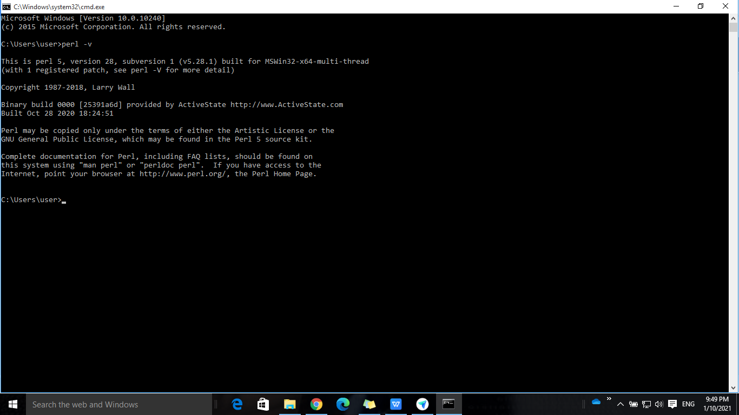
Perl Version

Slide 14
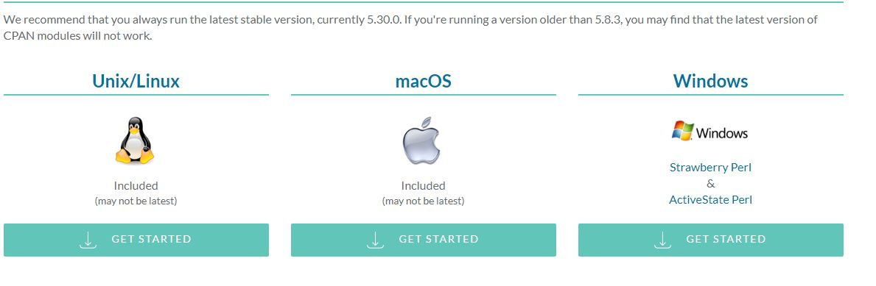
Downloading and Installing Perl
Downloading Perl:
Before starting with the installation process, you need to download it. For that, all versions of Perl for Windows, Linux, and MacOS are available on perl.org

Slide 15
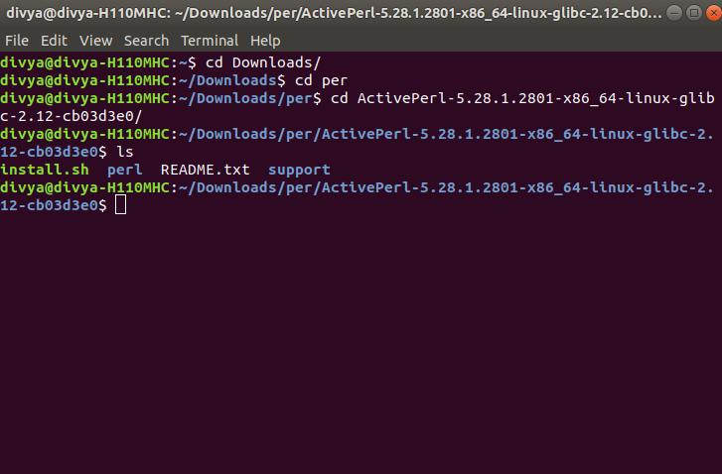
Beginning with the Installation in Linux:
Changing Directory to install Perl

Slide 16
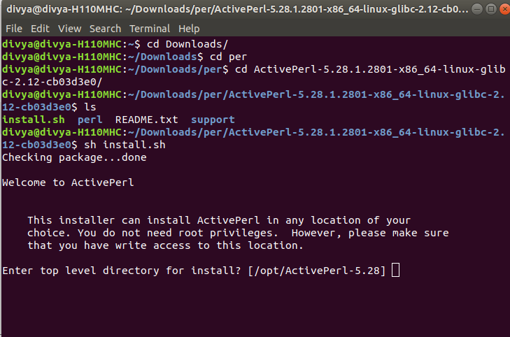
Starting the Installation Process:

Slide 17
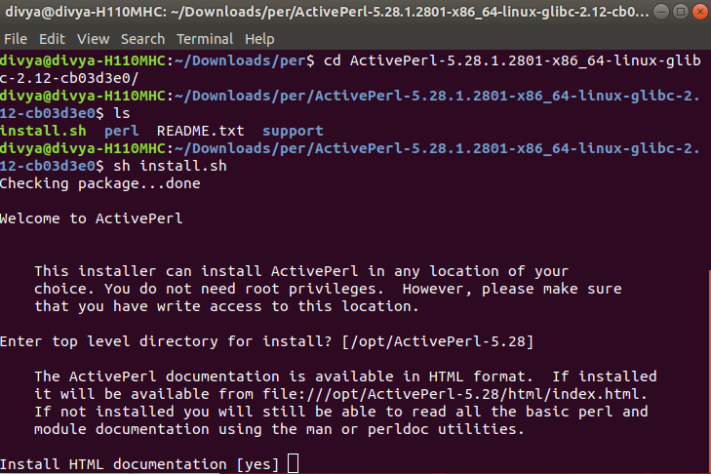
Choosing the Directory to Install Perl

Slide 18
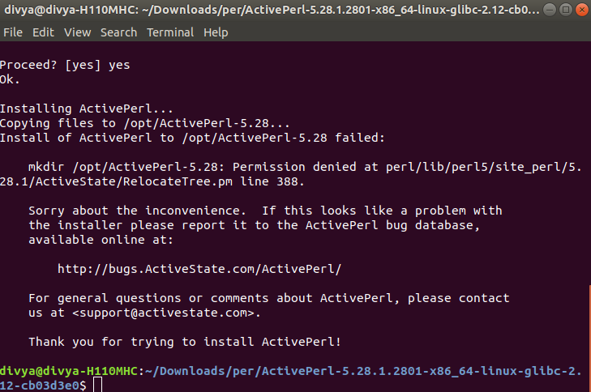
Finishing the Installation:

Slide 19
Done with installation (Linux)
After completing the Installation process, any IDE or text editor can be used to write Perl Codes and Run them on the IDE or the Command prompt with the use of command:
perl file.pl

Slide 20
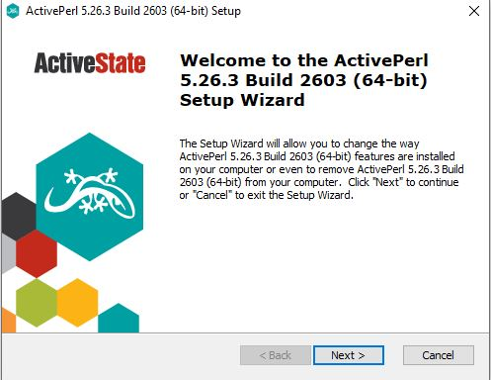
Beginning with the Installation(windows):

Slide 21
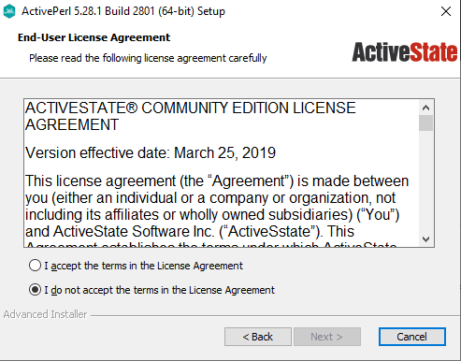
Getting done with the User’s License Agreement:

Slide 22
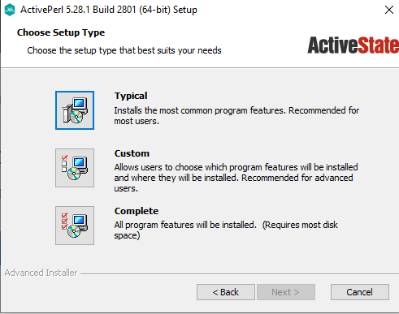
Choosing what to Install:

Slide 23
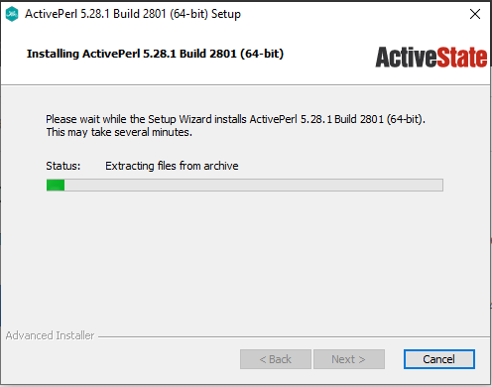
Installation Process

Slide 24
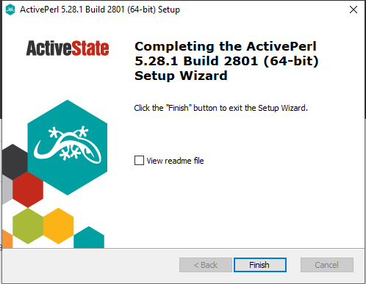
Finished Installation (windows)_

Slide 25
Basic Syntax of a Perl Program
Like other Programming Languages, Perl also follows a basic syntax for writing programs for applications and software or writing a simple Perl program.
This syntax contains some predefined words known as Keywords, Variables for storing values, expressions, statements for executing the logic, loops for iterating over a variable value, blocks for grouping statements, subroutines for reducing the complexity of the code, etc.
All these, when put together, will make a Perl program.
A Perl program whether it be a small code for addition of Two numbers or a Complex one for executing web scripts, uses these variables, statements and other parameters that comprise of a program’s syntax.

Slide 26
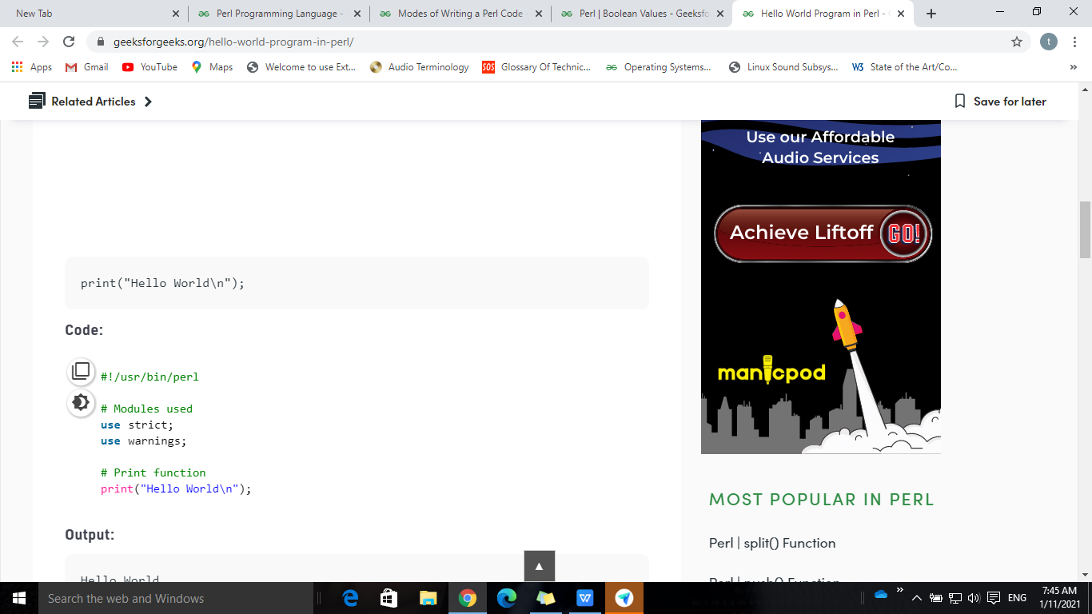
Hello World Program in Perl
Step 1: Transfer the file to Perl Interpreter:
Always in Perl, the first line starts with a pair of characters #!.
It insists Perl interpreter how the file should be executed.
Here, the file should be transferred to Perl interpreter that resides in /usr/bin/perl folder.
So, the first line of the program will go this way,
!/usr/bin/perl

Slide 27
Hello World Program in Perl in Cont..
Step 2: Pragma in Perl:
A pragma is a specific module in Perl package which has the control over some functions of the compile time or Run time behavior of Perl, which is strict or warnings. So the next two lines go like this,
use strict;
use warnings;
Step 3: Use of print() function:
Lastly displaying the output, We use print() function to display a string in perl.

Slide 28
How to Run a Perl Program?
Generally, there are two ways to Run a Perl program-
Using Online IDEs:You can use various online IDEs which can be used to run Perl programs without installing.
Using Command-Line:You can also use command line options to run a Perl program. Below steps demonstrate how to run a Perl program on Command line in Windows/Unix Operating System:
To compile the code type perl HelloWorld.pl. If your code has no error then it will execute properly and output will be displayed.

Slide 29
2.Fundamentals
Modes of Writing a Perl Code
Boolean Values
Operators
Variables
Variables and its Types
Scope of Variables
Modules in Perl
Number and its Types

Slide 30
Modes of Writing a Perl Code
Perl also supports multiple modes of writing and executing a Perl Code. These modes can be categorized on the basis of their writing compatibility and mode of execution in the following ways:
Interactive Mode
Script Mode
One-Liner Mode

Slide 31
Interactive Mode
Interactive mode of writing a Perl code means the direct interaction with the interpreter. Interactive mode is a good way to get started as it helps to check the flow of code line by line and makes the debugging process easier.
Interactive Mode in Perl can be used on the Command line with the use of Perl Debugger. This interpreter is commonly known as REPL– Read, Evaluate, Print, Loop.
perl -de1 will open the debugger mode in the Perl command line

Slide 32
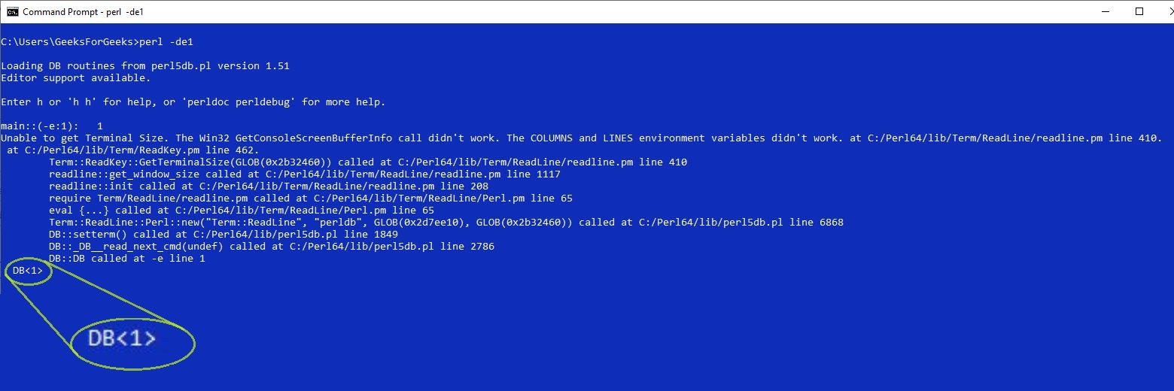
Interactive Mode Cont..

Slide 33
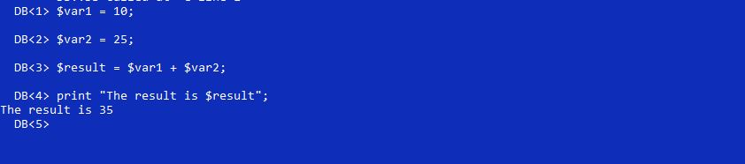
Interactive Mode Cont..
In the Interactive mode of Writing a Perl Code, the user has to write the code line by line and it gets executed at the same time.
Example: If we need to add two numbers and display the result then that can be done in the Interactive mode in the following manner:

Slide 34
Script Mode
Script Mode in Perl is used to write Perl programs which have more than a few lines of code and are a bit complex for the Interactive mode.
Script mode in Perl can be used by the help of a text editor to write the Perl program and to save it in a file called a script and then execute the saved file by using the command line.
This file must be saved with a .pl extension and should be placed in the same folder of which the directory path is given to the command line. This script is further run in the command line using the command:
perl File_Name.pl

Slide 35
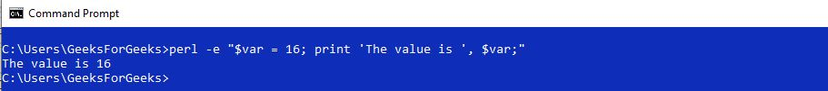
One-liner Mode
Perl also provides a one-liner mode, which allows to type and execute a very short script of code directly on the command line. This is done to avoid the creation of Files to store the script for codes which are not very lengthy. These codes can be typed on a single line in the command line mode with the help of the following command:
perl -e
This command is used to write and execute the one-liner code in the command line by writing it in the double quotes

Slide 36
Boolean Values
In most of the programming language True and False are considered as the boolean values.
But Perl does not provide the type boolean for True and False. In general, a programmer can use the term “boolean” when a function returns either True or False.
Like conditional statements(if, while etc.) will return either true or false for the scalar values.
True Values: Any non-zero number i.e. except zero are True values in the Perl language.
String constants like ‘true’, ‘false’, ‘ ‘(string having space as the character), ’00’(2 or more 0 characters) and “0\n”(a zero followed by a newline charatcer in string) etc. also consider true values in Perl.
False Values: Empty string or string contains single digit 0 or undef value and zero are considered as the false values in perl.

Slide 37
Operators
Operators are the main building block of any programming language.
Operators allow the programmer to perform different kinds of operations on operands.
In Perl, operators symbols will be different for different kind of operands(like scalars and string).
Arithmetic Operators
Relational Operators
Logical Operators
Bitwise Operators
Assignment Operators
Ternary Operator

Slide 38
Arithmetic Operators
These are used to perform arithmetic/mathematical operations on operands.
Addition: ‘+‘ operator is used to add the values of the two operands
Subtraction: ‘–‘ operator is used to subtract right hand operand from left hand operand.
Multiplication: ‘*‘ operator is used to multiplies the value on either side of the operator.
Division Operator: ‘/‘ operator returns the remainder when first operand is divided by the second
Modulus Operator: ‘%‘ operator is used to divide left hand operand from right operand and returns remainder
Exponent Operator: ‘**‘ operator is used to perform the exponential(power) calculation on operands

Slide 39
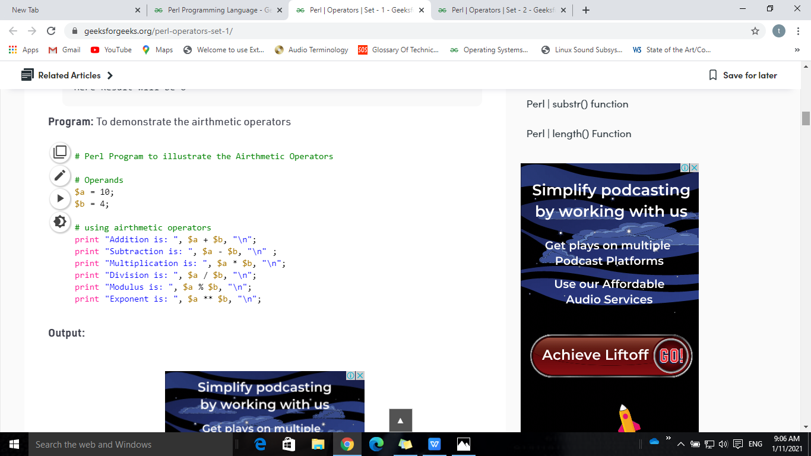
Arithmetic Operators Example:
Output:
Addition is: 14
Subtraction is: 6
Multiplication is: 40
Division is: 2.5
Modulus is: 2
Exponent is: 10000

Slide 40
Relational Operators
Relational operators are used for comparison of two values. These operators will return either 1(true) or nothing(i.e. 0(false)).
Equal To Operator: ‘==’ Check if two values are equal or not. If equals then return 1 otherwise return nothing.
Not equal To Operator: ‘!=’ Check if the two values are equal or not. If not equal then returns 1 otherwise returns nothing.
Comparison of equal to Operator: ‘< = >’ If left operand is less than right then returns -1, if equal returns 0 else returns 1.
Greater than Operator: ‘>’ If left operand is greater than right returns 1 else returns nothing.
Less than Operator: ‘<' If left operand is lesser than right returns 1 else returns nothing.
Greater than equal to Operator: ‘>=’ If left operand is greater than or equal to right returns 1 else returns nothing.
Less than equal to Operator: ‘<=' If left operand is lesser than or equal to right returns 1 else returns nothing.

Slide 41
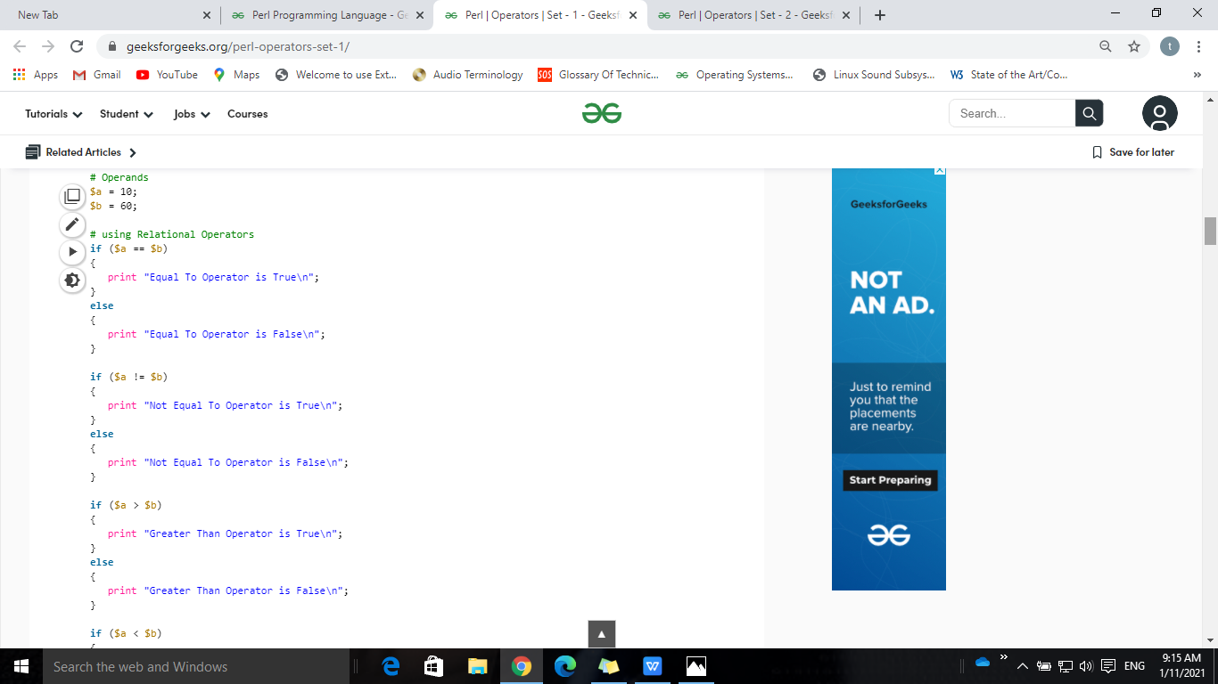
Relational Operators Cont..
Output:
Equal To Operator is False
Not Equal To Operator is True
Greater Than Operator is False

Slide 42
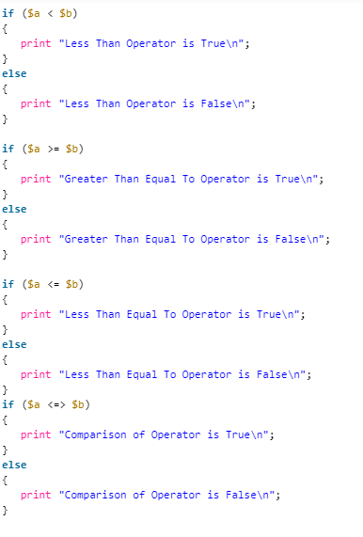
Relational Operators Cont..
Output:
Less Than Operator is True
Greater Than Equal To Operator is False
Less Than Equal To Operator is True
Comparison of Operator is True

Slide 43
Logical Operators
These operators are used to combine two or more conditions/constraints or to complement the evaluation of the original condition in consideration.
Logical AND: The ‘and’ operator returns true when both the conditions in consideration are satisfied. For example, $a and $b is true when both a and b both are true (i.e. non-zero). You can use also &&.
Logical OR: The ‘or’ operator returns true when one (or both) of the conditions in consideration is satisfied. For example, $a or $b is true if one of a or b is true (i.e. non-zero). Of course, it gives result “true” when both a and b are true. You can use also ||
Logical NOT: The ‘not’ operator will give 1 if the condition in consideration is satisfied. For example, not($d) is true if $d is 0.

Slide 44
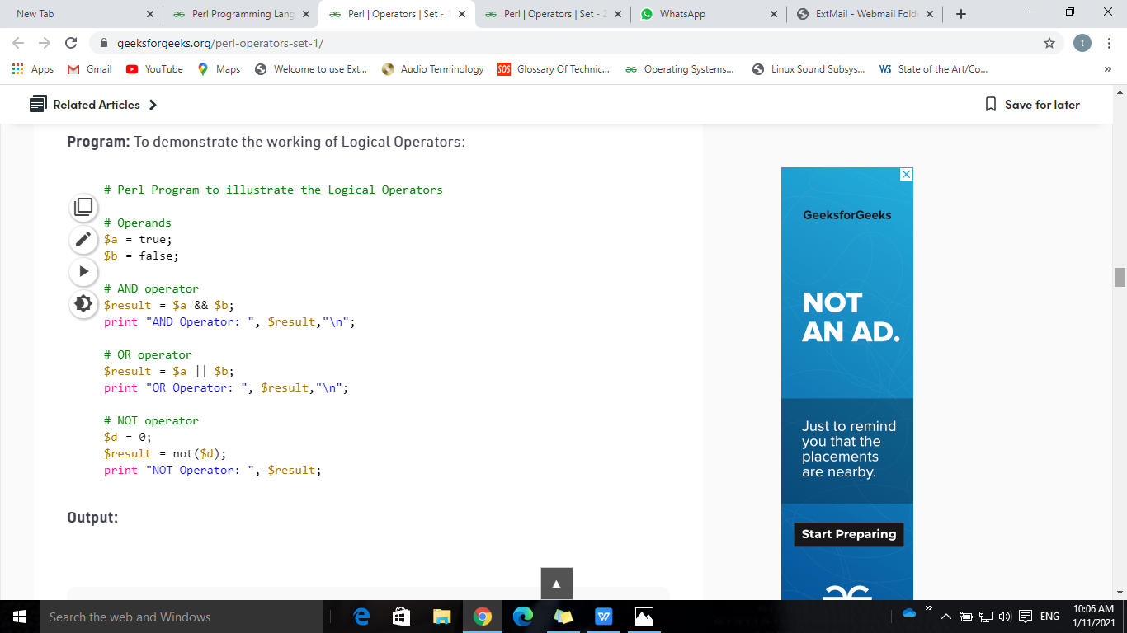
Logical Operators Cont..
Output:
AND Operator: false
OR Operator: true
NOT Operator: 1

Slide 45
Bitwise Operators
These operators are used to perform the bitwise operation.
It will first convert the number into bits and perform the bit-level operation on the operands.
& (bitwise AND) Takes two numbers as operands and does AND on every bit of two numbers. The result of AND is 1 only if both bits are 1
| (bitwise OR) Takes two numbers as operands and does OR on every bit of two numbers. The result of OR is 1 any of the two bits is 1
^ (bitwise XOR) Takes two numbers as operands and does XOR on every bit of two numbers. The result of XOR is 1 if the two bits are different.

Slide 46
Bitwise Operators Cont..
~ (Complement Operator) This is unary operator act as flipping bits. It’s work is to reverse the bits and gives reuslt using 2’s complement form due to a signed binary number
(<<) Binary Left Shift Operator will takes two numbers, left shifts the bits of the first operand, the second operand decides the number of places to shift. It performs multiplication of the left operand by the number of times spthe ecified by right operand.
(>>)Binary Right Shift Operator will take two numbers, right shifts the bits of the first operand, the second operand decides the number of places to shift. It performs division of the left operand by the number of times specified by right operand.

Slide 47
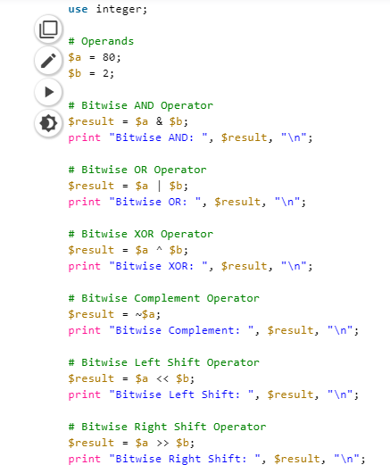
Bitwise Operators Program
Output:
Bitwise AND: 0
Bitwise OR: 82
Bitwise XOR: 82
Bitwise Complement: -81
Bitwise Left Shift: 320
Bitwise Right Shift: 20

Slide 48
Assignment Operators
Assignment operators are used to assigning a value to a variable.
The left side operand of the assignment operator is a variable and right side operand of the assignment operator is a value.
“=”(Simple Assignment) : This is the simplest assignment operator. This operator is used to assign the value on the right to the variable on the left.
“+=”(Add Assignment) : This operator is combination of ‘+’ and ‘=’ operators. This operator first adds the current value of the variable on left to the value on the right and then assigns the result to the variable on the left.
“-=”(Subtract Assignment) : This operator is combination of ‘-‘ and ‘=’ operators. This operator first subtracts the current value of the variable on left from the value on the right and then assigns the result to the variable on the left.

Slide 49
Assignment Operators
“*=”(Multiply Assignment) : This operator is combination of ‘*’ and ‘=’ operators. This operator first multiplies the current value of the variable on left to the value on the right and then assigns the result to the variable on the left.
“/=”(Division Assignment) : This operator is combination of ‘/’ and ‘=’ operators. This operator first divides the current value of the variable on left by the value on the right and then assigns the result to the variable on the left.
“%=”(Modulus Assignment) : This operator is combination of ‘%’ and ‘=’ operators. This operator first modulo the current value of the variable on left by the value on the right and then assigns the result to the variable on the left.
“**=”(Exponent Assignment) : This operator is combination of ‘**’ and ‘=’ operators. This operator first exponent the current value of the variable on left by the value on the right and then assigns the result to the variable on the left.

Slide 50
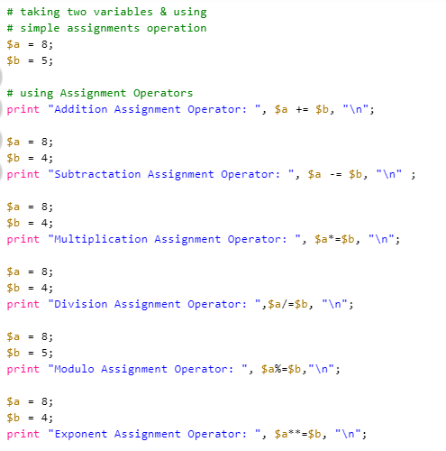
Assignment Operators Cont..
Output:
Addition Assignment Operator: 13
Subtractation Assignment Operator: 4
Multiplication Assignment Operator: 32
Division Assignment Operator: 2
Modulo Assignment Operator: 3
Exponent Assignment Operator: 4096

Slide 51
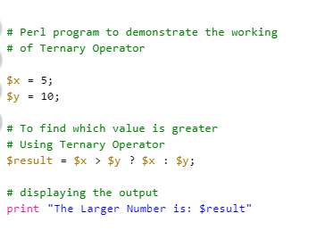
Ternary Operator
It is a conditional operator which is a shorthand version of if-else statement.
It has three operands and hence the name ternary.
Syntax
condition ? first_expression : second_expression;
Output:
The Larger Number is: 10

Slide 52
Operators Cont..
Quote Like Operators
String Manipulation Operators
Range Operator
Auto Increment & Decrement Operator
Arrow Operator

Slide 53
Quote-like Operators
In these operators, {} will represent a pair of delimiters that user choose. In this category there are three operators as follows:
q{ } : It will encloses a string in single quotes(”) and cannot interpolate the string variable. For Example: q{geek} gives ‘geek’.
qq{ }: It will encloses a string in double quotes(“”) and can interpolate the string variable. For Example: qq{geek} gives “geek”.
qx{ } : It will encloses a string in invert quotes(“). For Example: qq{geek} gives `geek`.

Slide 54
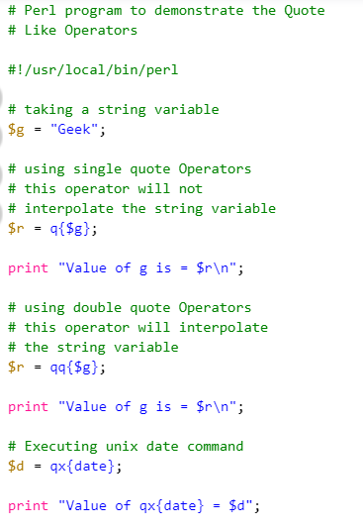
Quote-like Operators Cont..
Output:
Value of g is = $g
Value of g is = Geek
Value of qx{date} = Sun Aug 12 14:19:43 UTC 2018

Slide 55
String Manipulation Operators
String are scalar variables and start with ($) sign in Perl. The String is defined by the user within a single quote(”) or double quote(“”). There are different types of string operators in Perl, as follows:
Concatenation Operator (.) : Perl strings are concatenated with a Dot(.) symbol. The Dot(.) sign is used instead of (+) sign in Perl.
Repetition Operator (x): The x operator accepts a string on its left-hand side and a number on its right-hand side. It will return the string on the left-hand side repeated as many times as the value on the right-hand side.

Slide 56
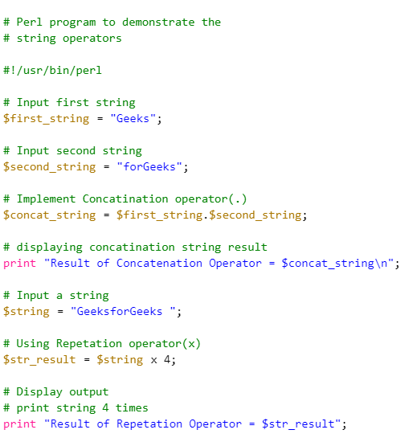
String Manipulation Operators Cont..
Output:
Result of Concatenation Operator = GeeksforGeeks
Result of Repetation Operator = GeeksforGeeks GeeksforGeeks GeeksforGeeks GeeksforGeeks

Slide 57
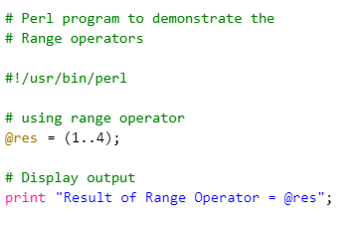
Range Operator(..)
In Perl, range operator is used for creating the specified sequence range of specified elements.
Ouput:
Result of Range Operator = 1 2 3 4

Slide 58
Auto Increment & Auto Decrement Operator
Auto Increment(++): Increment the value of an integer. When placed before the variable name (also called pre-increment operator), its value is incremented instantly.
For example, ++$x.
And when it is placed after the variable name (also called post-increment operator)
its value is preserved temporarily until the execution of this statement and it gets updated before the execution of the next statement
Auto Decrement(--):Decrement the value of an integer. When placed before the variable name (also called pre-decrement operator), its value is decremented instantly.
For example, –$x.
And when it is placed after the variable name (also called post-decrement operator)
its value is preserved temporarily until the execution of this statement and it gets updated before the execution of the next statement.

Slide 59
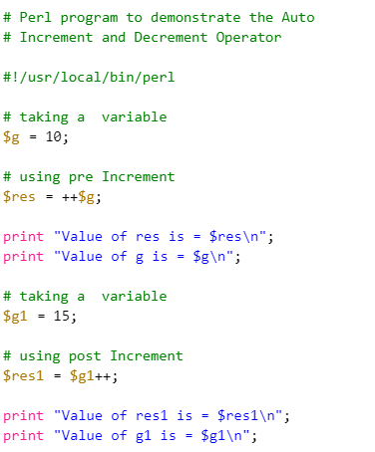
Auto Increment Cont..
Ouput:
Value of res is = 11
Value of g is = 11
Value of res1 is = 15
Value of g1 is = 16

Slide 60
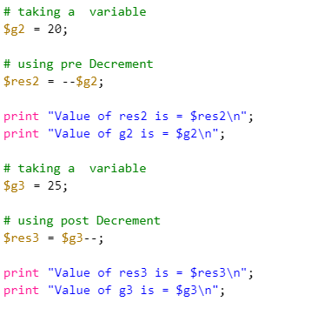
Auto Decrement Cont..
Output:
Value of res2 is = 19
Value of g2 is = 19
Value of res3 is = 25
Value of g3 is = 24

Slide 61
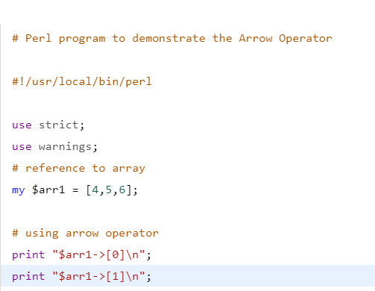
Arrow Operator(->)
This operator is used for dereferencing a Variable or a Method from a class or an object.
Example: $ob->$x is an example to access variable $x from object $ob.
Output:
4
5

Slide 62
Variables
Variables are user-defined words that are used to hold the values passed to the program which will be used to evaluate the Code. Every Perl program contains values on which the Code performs its operations. These values can’t be manipulated or stored without the use of a Variable. A value can be processed only if it is stored in a variable, by using the variable’s name.
A value is the data passed to the program to perform manipulation operation. This data can be either number, strings, characters, lists, etc.

Slide 63
$a = 5;
$b = "geeks";
$c = 15;
Variables
Values
The reserved memory locations to store values are the Variables.
This means that creating a variable, reserves a space in memory.
Data type of a variable helps the interpreter to allocate memory and decide what to be stored in the reserved memory.
Types Of Variables:
Scalar Variables
Array Variables
Hash Variables

Slide 64
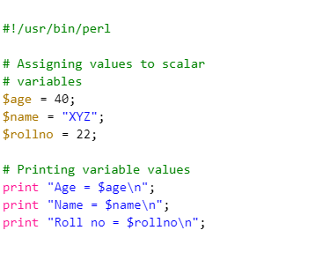
Scalar Variables
A scalar is a single unit of data. It is possible that the data might be an integer number, floating point, a character, a string, a paragraph, or an entire web page.
Here is an example of using scalar variables
Output:
Age = 40
Name = XYZ
Roll no = 22

Slide 65
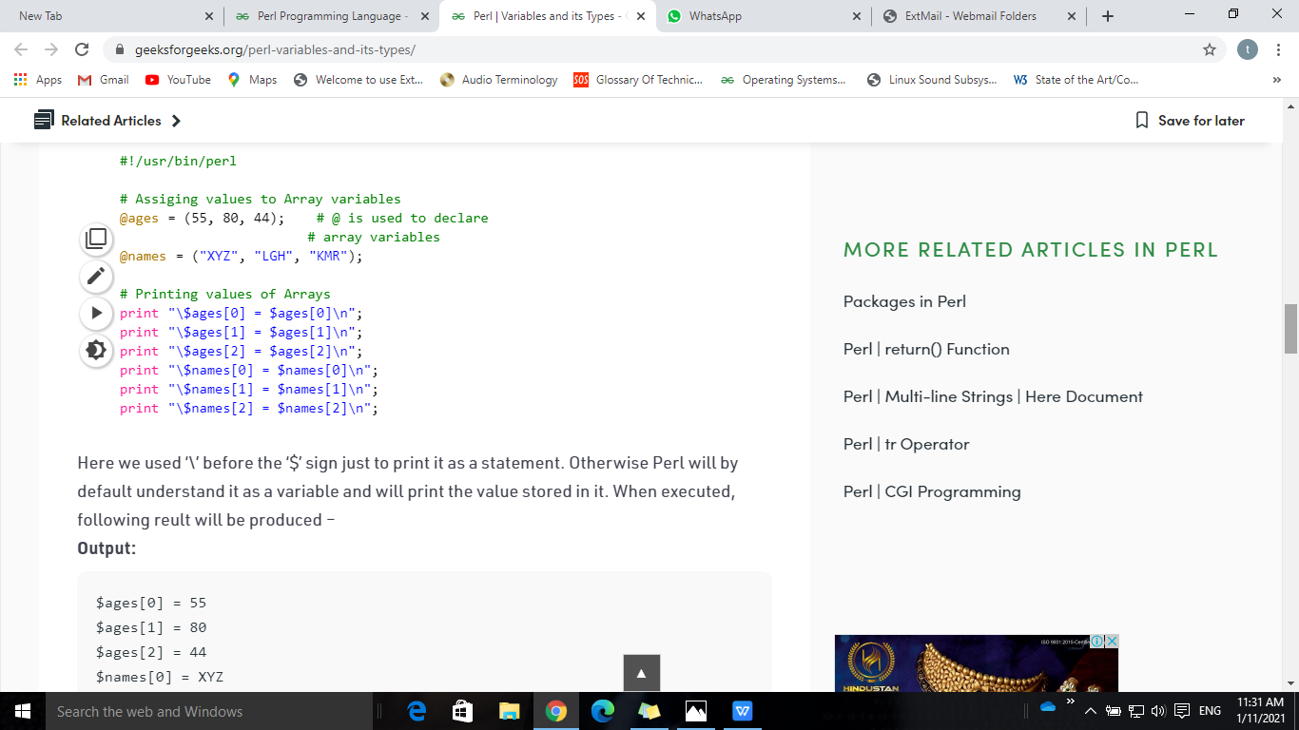
Array Variables
Variable that stores an ordered list of scalar values is of array type. Variables of Array Datatype are preceded by an “at” (@) sign. The dollar sign ($) is used to refer a single element of an array with the variable name followed by the index of the element in square brackets.
Here is an example of how to use an array variable:
Output:
$ages[0] = 55
$ages[1] = 80
$ages[2] = 44
$names[0] = XYZ
$names[1] = LGH
$names[2] = KMR

Slide 66
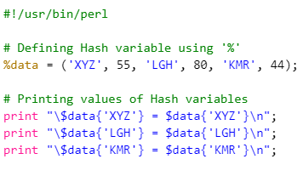
Hash Variables
A hash is a set of key/value pairs. Variables of the Hash type are preceded by a modulous (%) sign. Keys are used to refer to a single variable in the Hash. To access these elements, Hash variable name followed by the Key associated with the value is used in curly brackets.
Following is a simple example to show Hash Variable:
Output:
$data{'XYZ'} = 55
$data{'LGH'} = 80
$data{'KMR'} = 44

Slide 67
Scope of a Variable
The scope of a variable is the part of the program where the variable is accessible.
A scope is also termed as the visibility of the variables in a program.
In Perl, we can declare either Global variables or Private variables.
Scope of Global Variables:
It will be visible till the end of the file everywhere
global variables can directly use and are accessible from every part of the program.
Scope of Local Variables:
Private variables in Perl are defined using my keyword before a variable.
my keyword confines variables in a function or block in which it is declared.
Note: When private variables are used within a function or block, then they hide the global variables created with the same name.

Slide 68
Perl Module
A module in Perl is a collection of related subroutines and variables that perform a set of programming tasks.
Perl Modules are reusable. Various Perl modules are available on the Comprehensive Perl Archive Network (CPAN).
These modules cover a wide range of categories such as network, CGI, XML processing, databases interfacing, etc.
Creating a Perl Module
A modules name must be same as to the name of the Package and should end with .pm extension.

Slide 69
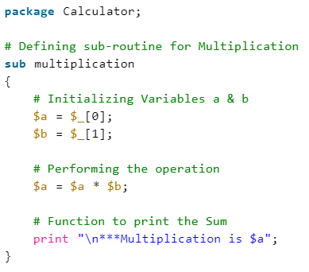
Creating a Perl Module
A modules name must be same as to the name of the Package and should end with .pm extension.
EX:Calculator.pm

Slide 70
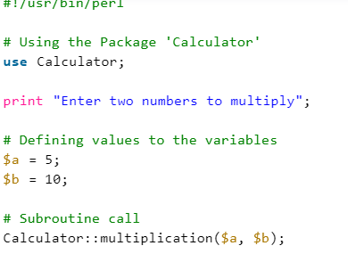
Importing and using a Perl Module
To import this calculator module, we use require or use functions. To access a function or a variable from a module, :: is used. Here is an example demonstrating the same:
Perl provides various pre-defined modules which can be used in the Perl programs anytime with the keyword use
Such as: ‘strict’, ‘warnings’, etc.

Slide 71
Number and its Types
A Number in Perl is a mathematical object used to count, measure, and perform various mathematical operations
These numbers as per their use can be categorized into various types:
Integers
Floating Numbers
Hexadecimal Numbers
Octal Numbers
Binary Numbers

Slide 72
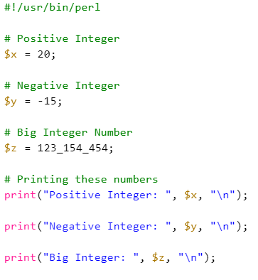
Integers:
Output:
Positive Integer: 20
Negative Integer: -15
Big Integer: 123154454
Perl integers are represented as decimal number with base 10. These numbers can be positive and negative both.

Slide 73
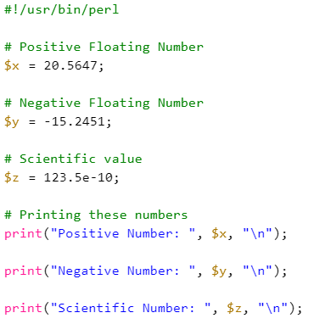
Floating Numbers
Output:
Positive Number: 20.5647
Negative Number: -15.2451
Scientific Number: 1.235e-08
Floating point numbers in Perl are those which contain integer as well as fractional values separated by a decimal point. The integer part of a Floating Number could be positive or negative both but the fractional value can only be a positive value.

Slide 74
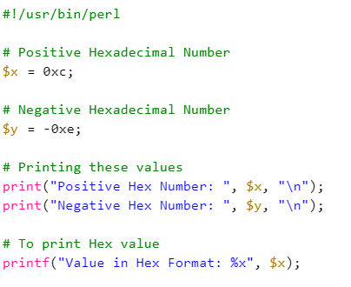
Hexadecimal Numbers
Output:
Positive Hex Number: 12
Negative Hex Number: -14
Value in Hex Format: c
Hexadecimal numbers are numbers with base 16 i.e. they range from 0-15 represented as 0xa with ‘0x’ preceding the number whereas ‘a’ here is the value of 10 in Hex form.
‘%x’ is used to print the value in its hexadecimal form

Slide 75
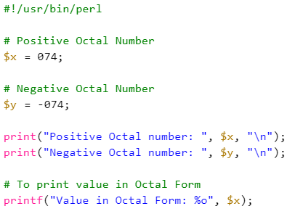
Octal Numbers
Output:
Positive Octal number: 60
Negative Octal number: -60
Value in Octal Form: 74
Octal numbers are the numbers with base 8 i.e. they range from 0-7. These numbers are represented as 057 with ‘0’ preceding the number and the rest part is the octal value of the required decimal number.
Here, ‘%o’ is used to print the value in its octal form

Slide 76
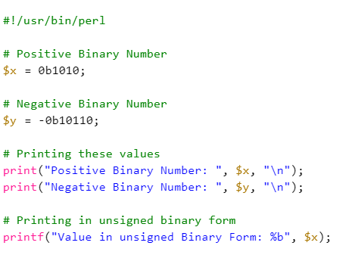
Binary Numbers
Output:
Positive Binary Number: 10
Negative Binary Number: -22
Value in unsigned Binary Form: 1010
Binary numbers are number with base 2 i.e. they are formed of only two values 0 and 1. These numbers are represented as 0b1010 with ‘0b’ preceding the number.
‘%b’ is used to print the number in its actual binary form.

Slide 77
3.Data Types
Data types specify the type of data that a valid Perl variable can hold.
There is no need to specify a type for the data while using in the Perl program.
The Perl interpreter will choose the type based on the context of the data itself.
Scalars
Arrays
Hashes(Associative Arrays)
Strings

Slide 78
Scalars
A scalar is a variable that stores a single unit of data at a time.
The data that will be stored by the scalar variable can be of the different type like string, character, floating point, a large group of strings or it can be a webpage and so on.
Numeric Scalars:
Numeric scalar variables hold values like whole numbers, integers(positive and negative), float(containing decimal point). The following example demonstrates different types of numerical scalar variables in perl.
String Scalars
String scalar variables hold values like a word(made of different characters), a group of words or a paragraph

Slide 79
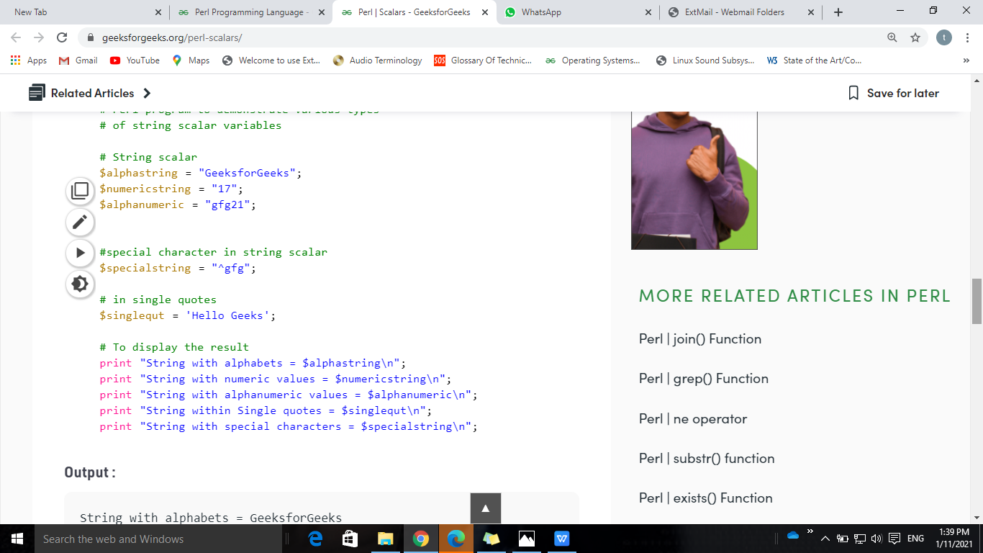
Scalars Cont..
Output:
String with alphabets = GeeksforGeeks
String with numeric values = 17
String with alphanumeric values = gfg21
String within Single quotes = Hello Geeks
String with special characters = ^gfg

Slide 80
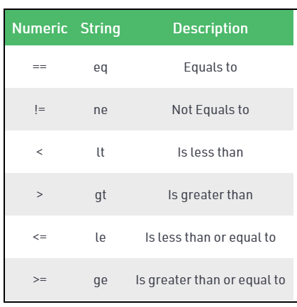
Comparing Scalars
These operators compare scalars.
One is for numeric scalar values and one is for string scalar values.
==,!=,<,>,<=,>= are work for Numeric Scalars
==,!=,<,>,<=,>= and eq,ne,lt,gt,le and ge are work for both Numeric and String Scalars

Slide 81
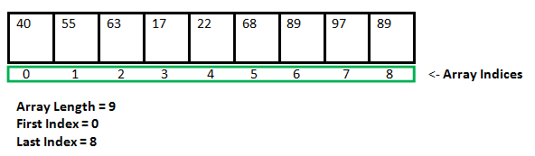
Array
In Perl, array is a special type of variable.
The array is used to store the list of values and each object of the list is termed as an element.
Elements can either be a number, string, or any type of scalar data including another variable.
In Perl programming every array variable is declared using “@” sign before the variable’s name
Array can be shown below,

Slide 82
Creation and accesssing array
Creation of array:
@number = (50, 70, 46);
@names = ("Geeks", "For", "Geeks");
Accessing Array Elements:
For accessing the elements of an array we must prefix “$” sign before the array variable name followed by the index in square brackets.
print "$arr[0]\n";
We can also give a negative index.
But giving negative index will result in selecting the array elements from ending not from the beginning.

Slide 83
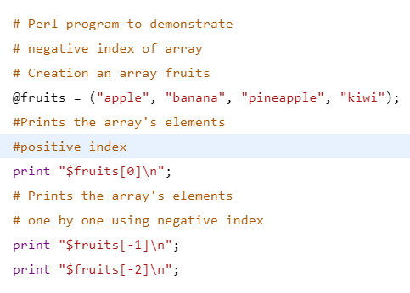
Accessing Array with positive and negative index
Output:
apple
kiwi
pineapple

Slide 84
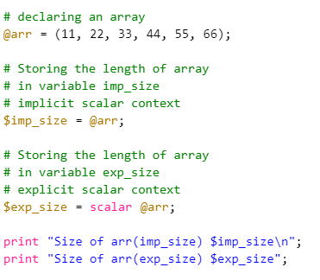
Size of an Array
Implicit Scalar Context
$size = @array;
Explicit scalar context using keyword scalar
$size = scalar @array;
Output:
Size of arr(imp_size) 6
Size of arr(exp_size) 6

Slide 85
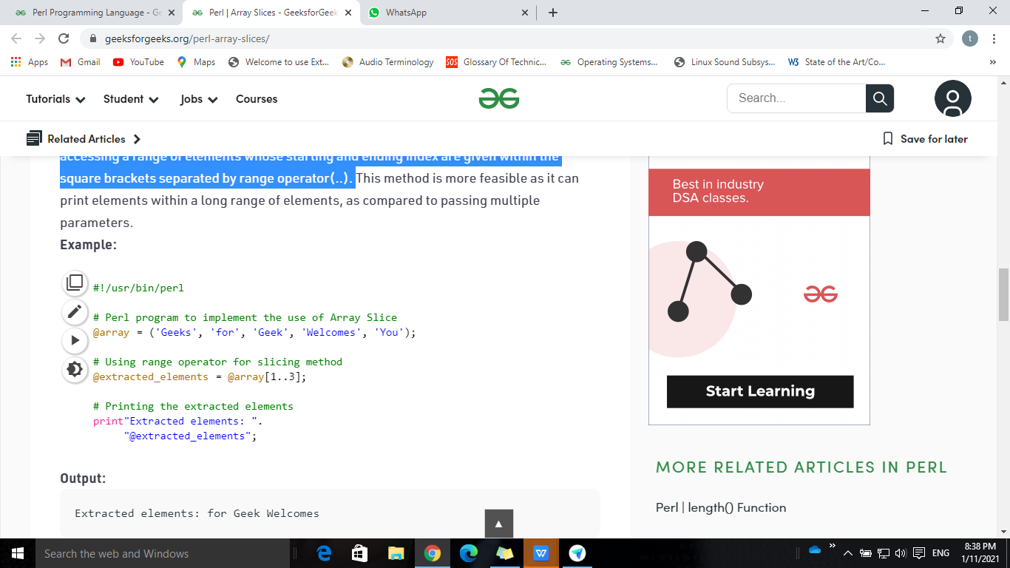
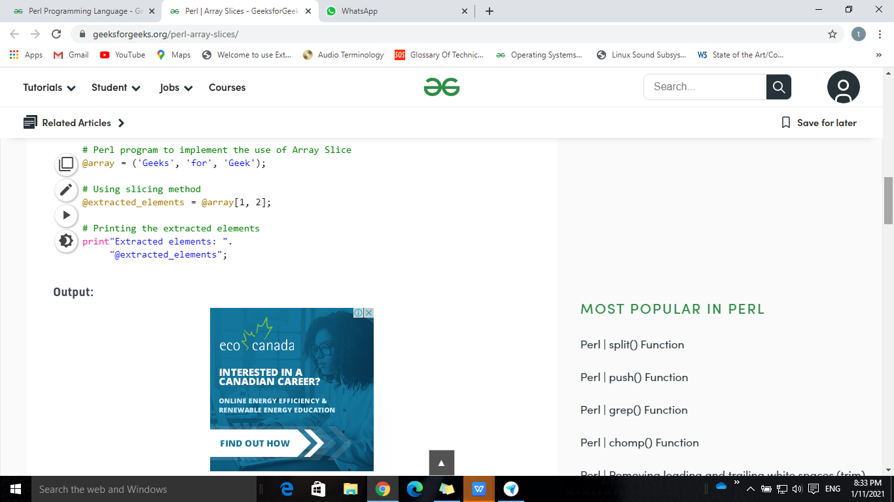
Slicing of an Array
Array slicing is done to access a range of elements in an array in order to ease the process of accessing a multiple number of elements from the array.
1. Passing multiple index values 2. Using range operator
Output
Extracted elements: for Geek
Output:
Extracted elemenExtracted elements: for Geek Welcomests: for Geek

Slide 86
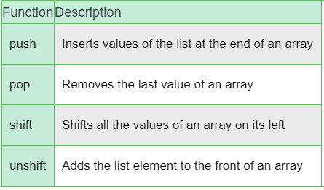
inbuilt functions in an array

Slide 87
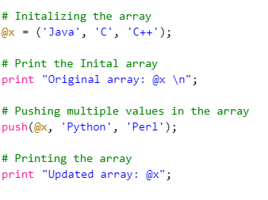
Push Operation
This function inserts the values given in the list at an end of an array. Multiple values can be inserted separated by comma. This function increases the size of an array. It returns number of elements in new array.
Syntax: push(Array, list)
Output:
Original array: Java C C++
Updated array: Java C C++ Python Perl

Slide 88
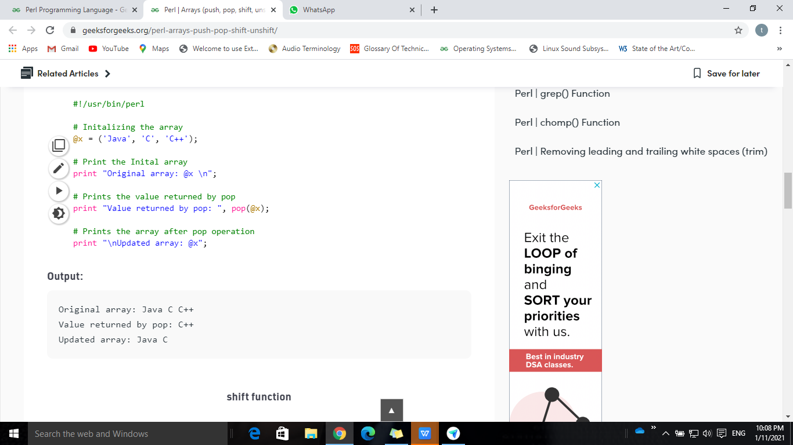
pop function
This function is used to remove the last element of the array.
After executing the pop function, size of the array is decremented by one element.
This function returns undef if list is empty otherwise returns the last element of the array.
Syntax: pop(Array)
Output:
Original array: Java C C++
Value returned by pop: C++
Updated array: Java C

Slide 89
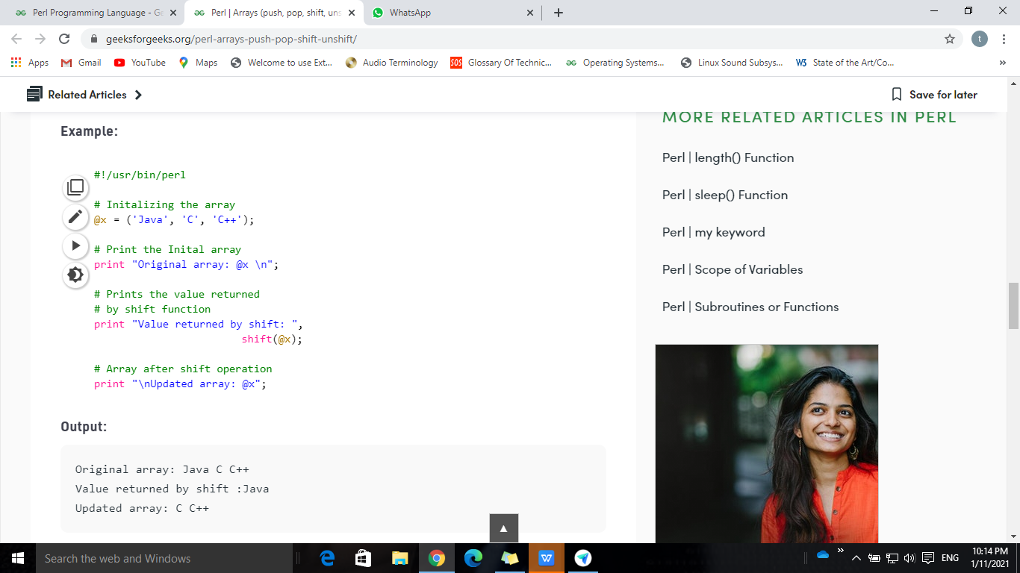
shift function
This function returns the first value in an array, removing it and shifting the elements of the array list to the left by one.
Shift operation removes the value like pop but is taken from the start of the array instead of the end as in pop
Syntax: shift(Array)
Output:
Original array: Java C C++
Value returned by shift :Java
Updated array: C C++

Slide 90
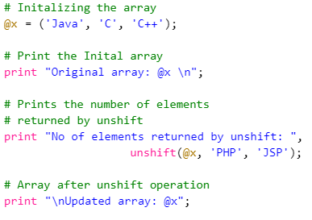
unshift function
This function places the given list of elements at the beginning of an array. Thereby shifting all the values in an array by right.
Multiple values can be unshift using this operation.
This function returns the number of new elements in an array.
Syntax: unshift(Array, List)
Output:
Original array: Java C C++
No of elements returned by unshift :5
Updated array: PHP JSP Java C C++

Slide 91
Hash
A hash is a set of key-value pairs. Perl stores elements of a hash such that it searches for the values based on its keys.
Hash variables start with a ‘%’ sign.
Perl requires the keys of a hash to be strings, whereas the values can be any scalars.
Creating Hashes:
The value is directly assigned-->
list which gets converted to hash by taking individual pairs.
%stud = ('Comp', 45, 'Inft', 42, 'Extc', 35);
3. using => to indicate the key/value pairs
%stud = ('Comp' => 45, 'Inft' => 42, 'Extc' => 35);
$stud{'Comp'} = 45;
$stud{'Inft'} = 42;
$stud{'Extc'} = 35;

Slide 92

Accessing Hash Elements
To access the individual element from the hash, variable is prefixed with a dollar sign ($) and then append the element key within curly braces after the name of the variable.
Output:
Printing values of Hash1
10
20
30

Slide 93
Extracting Keys and Values in Hashes
Sometimes there is a need to extract keys and values of a hash to perform various operations on it.
Operations like element modification, deletion, addition, etc.
Hash allows to extract these keys and values with the use of inbuilt functions.
Getting a list of all of the keys from a hash can be done using keys function.
Syntax: keys %HASH
Returns an array of all the keys present in the HASH
values function is used to get a list of all the values.
Syntax: values %HASH
Returns an array with all the values of HASH

Slide 94


Keys & values functions
Output:
Keys are :
Comp
Extc
Inft
Output:
Values are :
45
35
42

Slide 95
Strings Cont..
The String is defined by the user within a single quote (‘) or double quote (“).
strings defined in single-quotes and those defined in double-quotes are treated differently.
Double-quoted strings:
Double-quoted strings are interpolated i.e. variable names (scalars, arrays, and hashes) are replaced by their original values and escape sequences (like /t, /n, etc.) do their work.
qq operator can also be used in place of double-quoted strings.
Single-quoted strings:
Single-quoted strings are not interpolated. They are interpreted as is, with no modifications whatsoever. q operator in Perl provides the same use as the single-quoted string.

Slide 96

single & double-quoted strings
Output:
Using Single quotes: @list
Using Double-quotes: 1 2 3 4 5 6 7 8 9 10

Slide 97


Slide 98

4.Input and Output
To display this evaluated expression, Perl uses print() function and say() function.
These functions can display anything passed to them as arguments.
print operator in Perl is used to print the values of the expressions in a List passed to it as an argument.
Syntax:
print "";
Output:
Geeks For Geeks
Welcomes you all

Slide 99

Input and Output Cont..
say() function in Perl works similar to the print() function but there’s a slight difference, say() function automatically adds a new line at the end of the statement, there is no need to add a newline character ‘\n’ for changing the line.
Output:
Geeks For Geeks
Welcomes you all

Slide 100

Use of STDIN for Input
Perl allows the programmer to accept input from the user to perform operations on
Input to a Perl program can be given by keyboard with the use of <STDIN>
Here, STDIN stands for Standard Input
chomp() will remove the newline character added to the end of the Input provided by the user.
Input
GeeksForGeeks
Output:
Enter some text: GeeksForGeeks
You Entered GeeksForGeeks
as a String

Slide 101
5.Control Flow Statements
In programming, a certain block of code needs to be executed when some condition is fulfilled.
A programming language uses control statements to control the flow of execution of the program based on certain conditions.
Decision Making Statements in Perl :
If
If – else
Nested – If
if – elsif ladder
Unless
Unless – else
Unless – elsif

Slide 102


Control Flow Statements Cont..
if statement:
if a certain condition is true then a block of statement is executed otherwise not.
it is must to use the brackets { } with if statement.
if-else statement:
The if statement evaluates the code if the condition is true but what if the condition is not true, here comes the else statement.
It tells the code what to do when the if condition is false.
Output:
Even Number
Output:
Odd Number

Slide 103


Control Flow Statements Cont..
Nested – if Statement:
if statement inside an if statement is known as nested if.
if-elif-else ladder statement:
The if statements are executed from the top down. As soon as one of the conditions controlling the if is true, the statement associated with that get executed, and the rest of the ladder is bypassed.
Output:
Number is divisible by 2 and 5
Output:
Odd Number

Slide 104


Control Flow Statements Cont..
unless Statement
if the condition is false then the statements will execute.
The number 0, the empty string “”, character ‘0’, the empty list (), and undef are all false in a boolean context and all other values are true.
Unless-else Statement
Unless statement can be followed by an optional else statement, which executes when the boolean expression is true.
Output:
a is not equal to 10
Output:
a is equal to 10

Slide 105
Loops
Looping in programming languages is a feature which facilitates the execution of a set of instructions or functions repeatedly while some condition evaluates to true.
The loops in Perl are :
for loop
foreach loop
while loop
do…. while loop
until loop
Nested loops

Slide 106
For Loop
“for” loop provides a concise way of writing the loop structure. Unlike a while loop, a for statement consumes the initialization, condition and increment/decrement in one line thereby providing a shorter, easy to debug structure of looping.
Syntax:
for (init statement; condition; increment/decrement )
{
# Code to be Executed
}
The flow of control can be determined by the following :
init statement: This is the first statement which is executed. In this step, we initialize a variable which controls the loop.
condition: In this step, the given condition is evaluated and the for loop runs if it is True. It is also an Entry Control Loop as the condition is checked prior to the execution of the loop statements.
Statement execution: Once the condition is evaluated to true, the statements in the loop body are executed.
increment/decrement: The loop control variable is changed here (incremented or decremented) for updating the variable for next iteration.
Loop termination: When the condition becomes false, the loop terminates marking the end of its life cycle.

Slide 107
foreach Loop
A foreach loop is used to iterate over a list and the variable holds the value of the elements of the list one at a time.
It is majorly used when we have a set of data in a list and we want to iterate over the elements of the list instead of iterating over its range.
The process of iteration of each element is done automatically by the loop.
Syntax
foreach variable
{
# Code to be Executed
}

Slide 108


For & Foreach loop examples
Output
GeeksForGeeks
GeeksForGeeks
GeeksForGeeks
Output
GEEKSFORGEEKS

Slide 109
while and do-while loops
A while loop generally takes an expression in parenthesis. If the expression is True then the code within the body of while loop is executed.
It is also known as a entry controlled loop as the condition is checked before executing the loop
Syntax :
while (condition)
{
# Code to be executed
}
do..while loop runs at least one time. The condition is checked after the first execution.
A do..while loop is used when we want the loop to run at least one time.
It is also known as exit controlled loop as the condition is checked after executing the loop
Syntax :
do {
# statments to be Executed
} while(condition);

Slide 110


while and do-while loops Examples:
Ouput:
GeeksForGeeks
GeeksForGeeks
GeeksForGeeks
GeeksForGeeks
Ouput:
10 9 8 7 6 5 4 3 2 1

Slide 111

Until Loop
It takes a condition in the parenthesis and it only runs until the condition is false.
Syntax:
until (condition)
{
# Statements to be executed
}
Output:
10 9 8 7 6 5 4 3 2 1

Slide 112

given-when Statement
given-when statement in Perl is a substitute for long if-statements that compare a variable to several integral values.
given-when in Perl is similar to the switch-case of C/C++
Syntax:
given(expression)
{
when(value1) {Statement;}
when(value2) {Statement;}
default {# Code if no other case matches}
}
Input:
4
Output:
Enter a day-code between 0-6
Thursday

